Slide 1

Pawsitive Insights: Unleashing Data Science in Animal Shelters
Domain Area : Animal Welfare Organization
By
Adarsh Mahor
Juily Pachundkar
Kalp Mepani
Manish Vankudre
Mayuresh Dongare

Slide 2

Project Objective:
Presentation Overview:
Intake and Adoption Trends
Breed Analysis
Age Demographics
Resource Allocation
Impact and Recommendations
How Data Science can lead to meaningful improvements in the management of animal shelters.

Slide 3
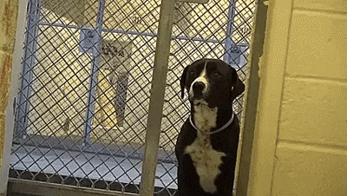
Why Animal Shelters Matter?
Providing a safe haven for homeless animals.
Promoting animal welfare and responsible pet ownership.
Contributing to public health and safety by controlling animal populations.
Offering adoption services that connect pets with loving homes.

Slide 4
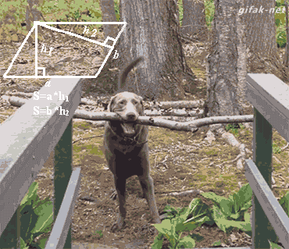
Challenges They Face:
Any Solution ?
Overpopulation
Resource Constraints
Health Issues
Efficient Management

Slide 5
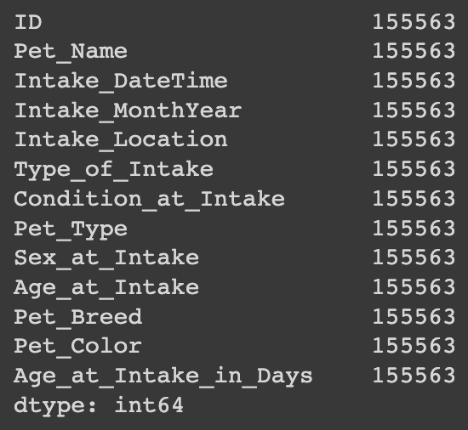
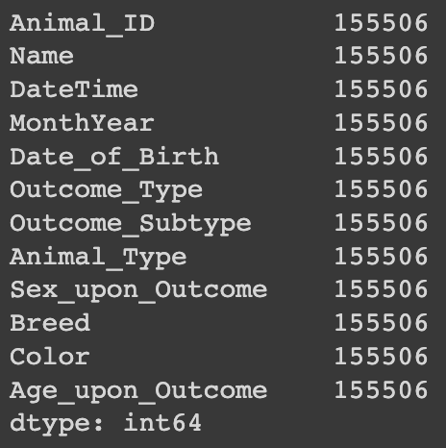
Analysis on the dataset:
Animal Intakes :
Animals Adopted :
Data Source : Dataset Link! Organization Website : Animal Shelter

Slide 6
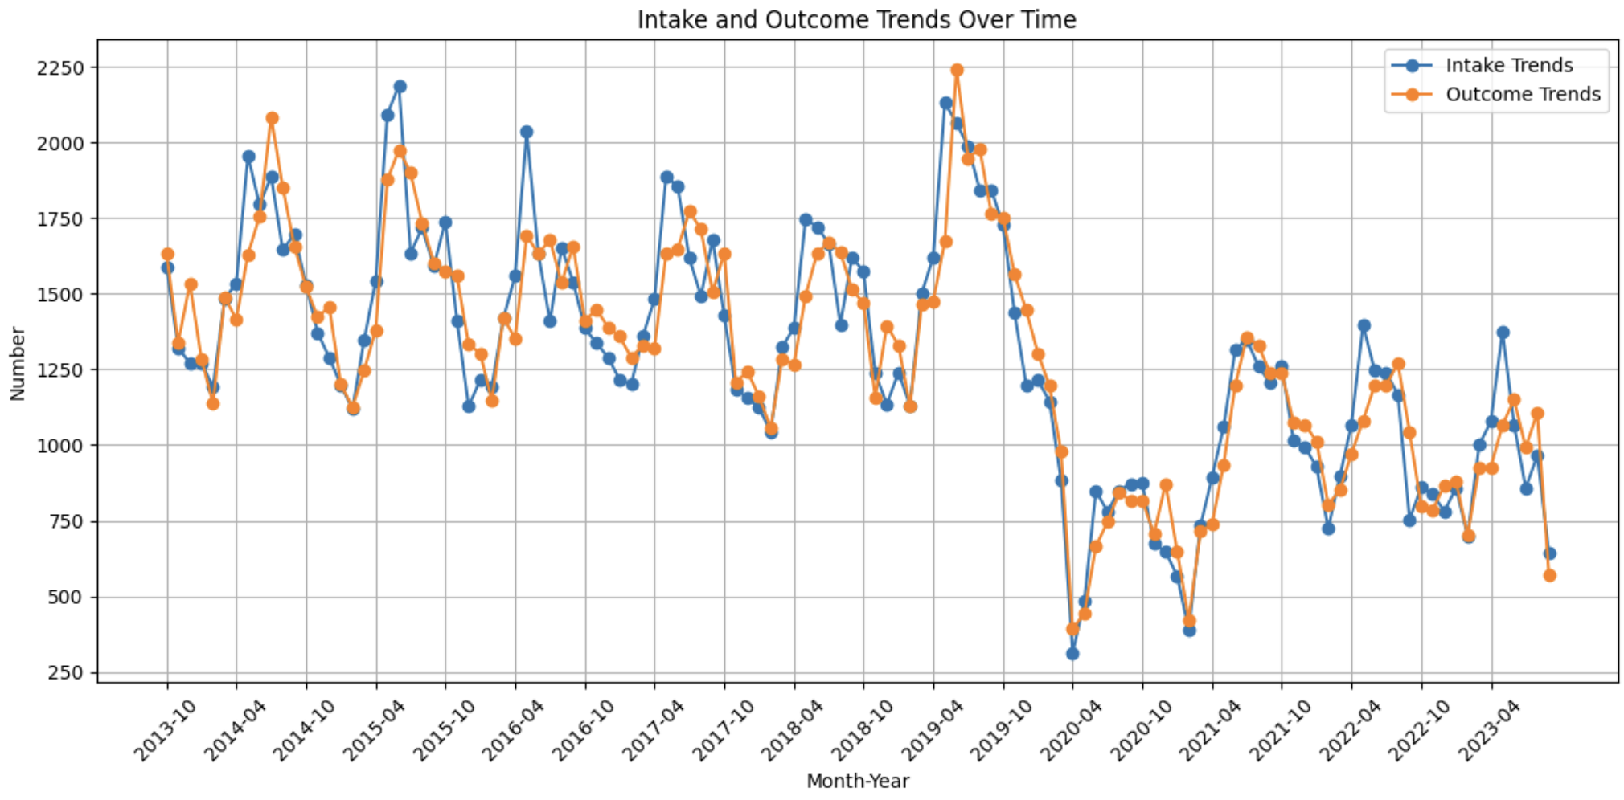
Intake and outcome Trend (2013 -2023) :

Slide 7
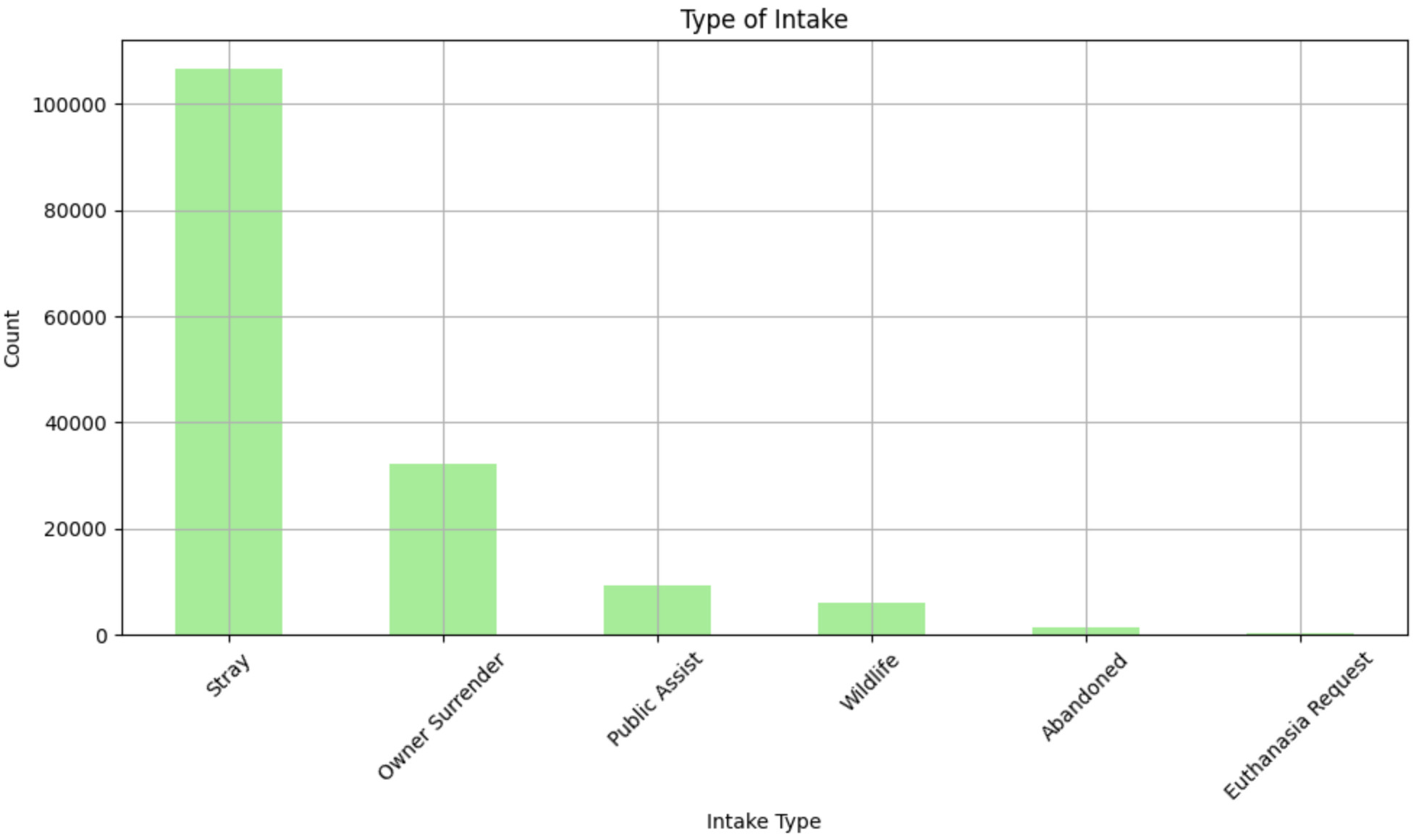
Intakes :

Slide 8
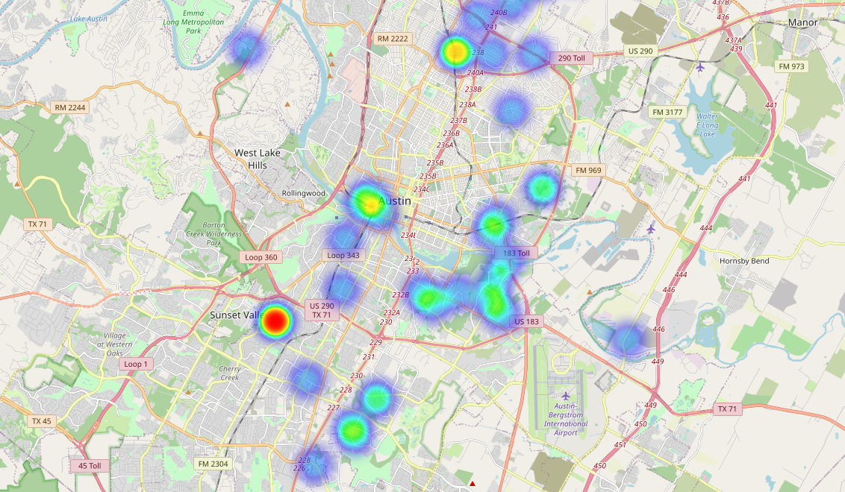
Location of Stray Animals Intakes :
Dynamic Stray Map Link: HeatMap of Stray Animals

Slide 9
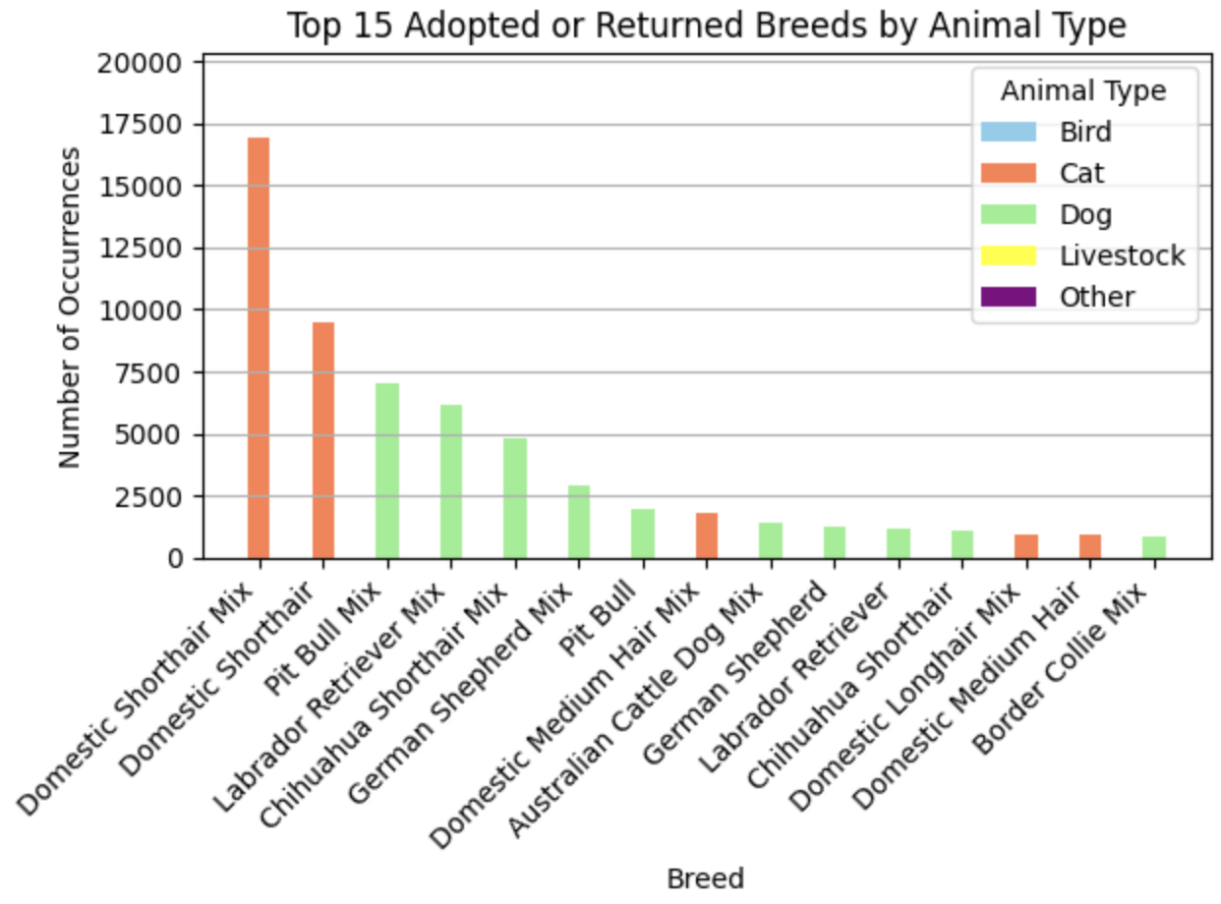
Breed and animal Type analysis:

Slide 10
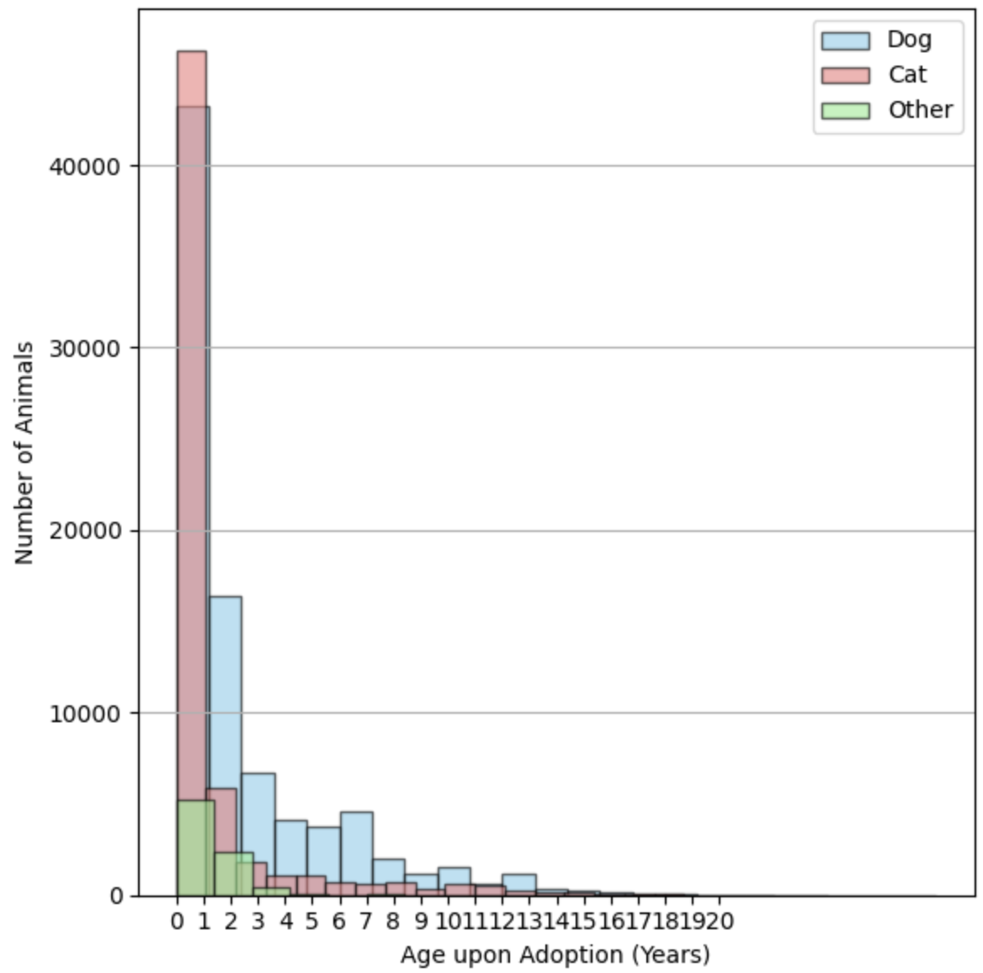
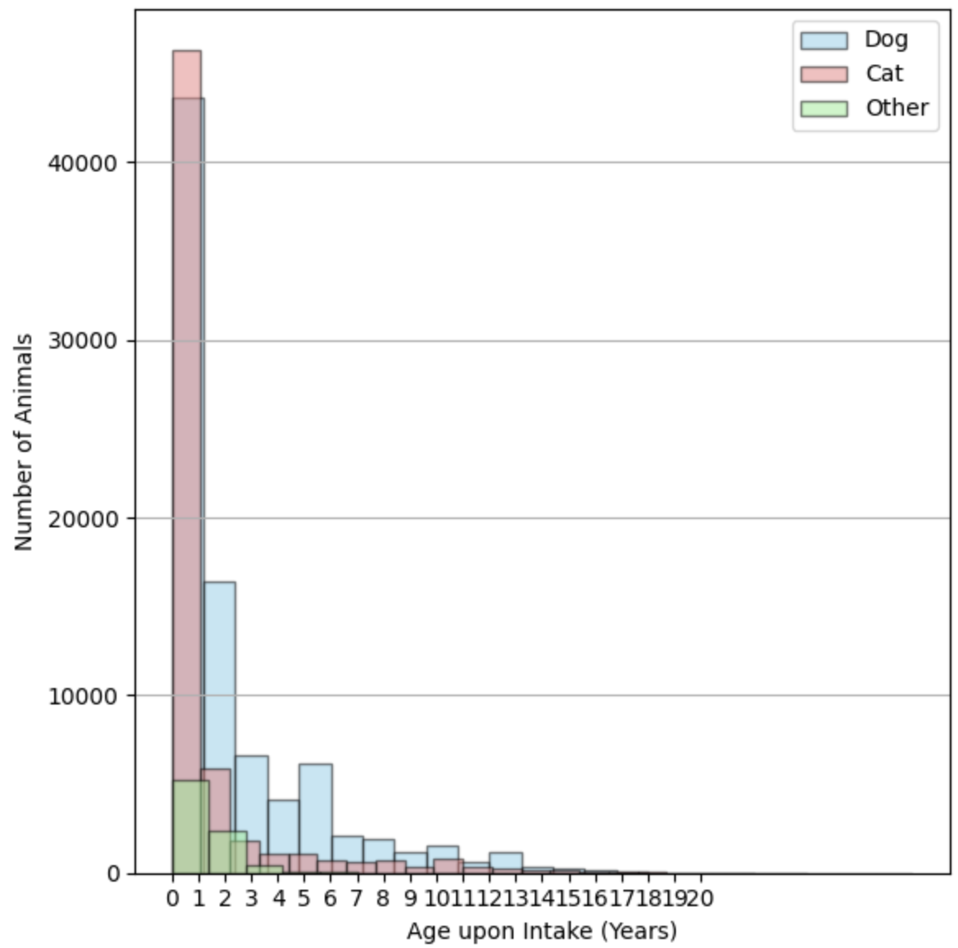
Age analysis :

Slide 11
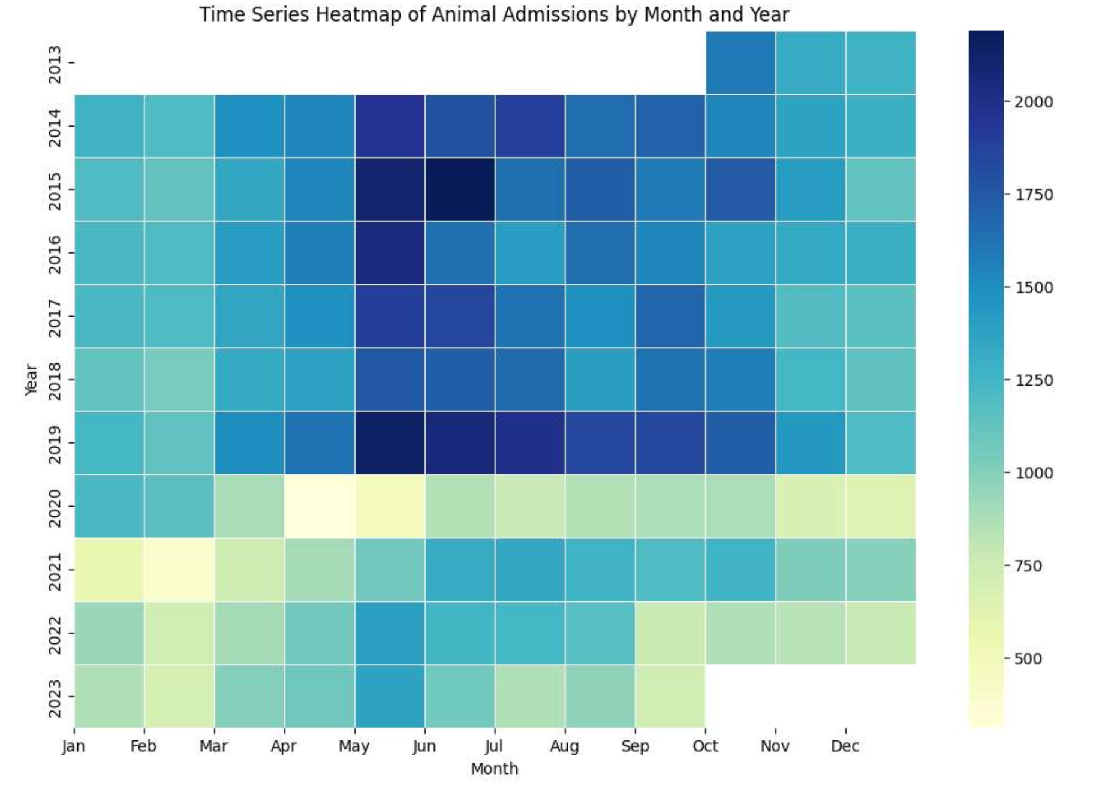
Resource Allocation :
Resource Allocation Models:
linear programming or optimization techniques can be used to allocate resources (e.g., staff, kennels, medical supplies)
Benefits :
It can maximize the number of adoptions while staying within budget constraints.

Slide 12
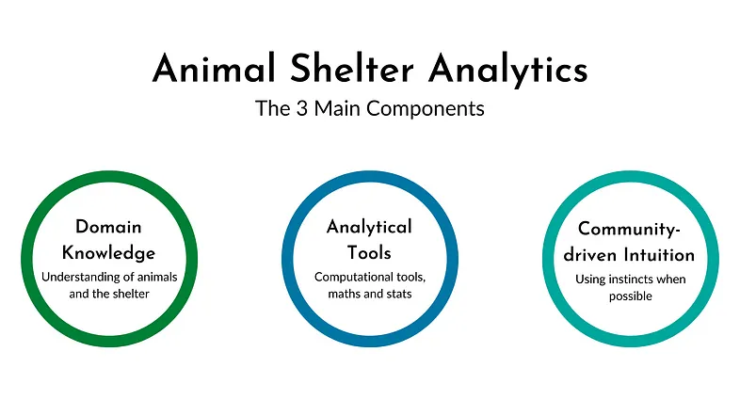
Impacts :
Recommendations :
Improved Operational Efficiency
Enhanced Resource Allocation
Reduction in Euthanasia
Community Engagement
Targeted Adoption Campaigns
Intake Management Strategies
Volunteer Programs Alignment
Partnerships and Collaborations

Slide 13
Recap of Main Points :
We discovered trends in intake and adoption, breed and age group patterns, and identified opportunities for operational improvement.
Stray Map helps track Hotspots of Stray Animal Activity which improves efficiency in Rescue operations.
By insights of the Data, shelters can optimize resource allocation, improve adoption rates and enhance well being of animals in care.
20%
40%
60%
80%
100%
Continued Data Analysis
Enhanced Resource Allocation
Collaboration & Continuous Improvement
Global Impact
Increased Adoption Rates &
Stray Animal Control

Slide 14
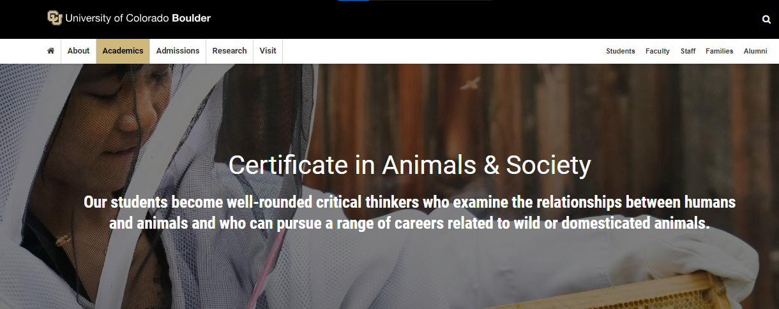
COURSE Related to Domain Area AT CU Boulder :
University of Colorado Boulder Course related to this topic
Link: Certificate in Animal and Society

Slide 15
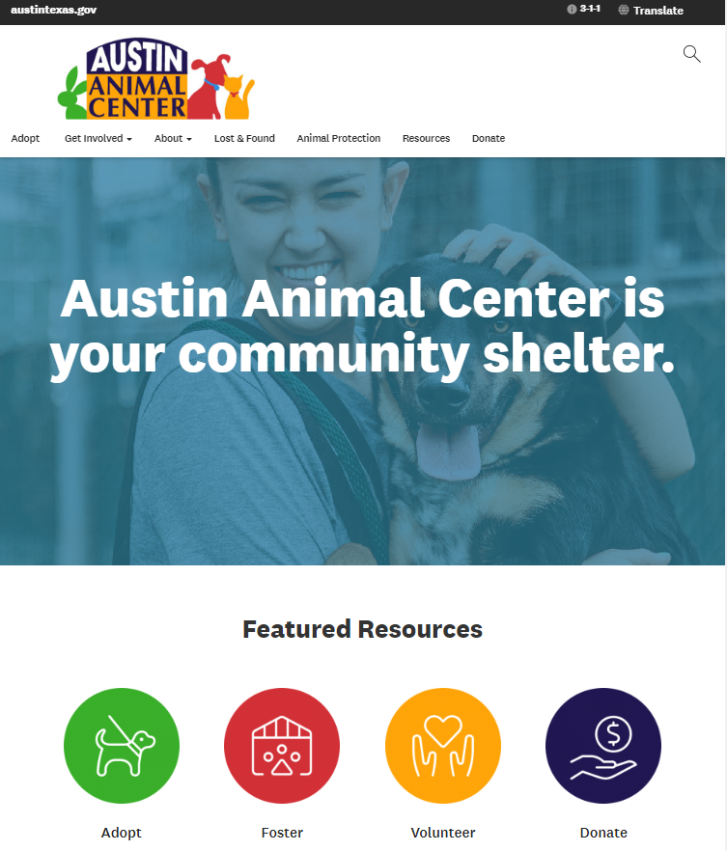
Resources :
Austin Animal Center
Data Source : austintexas.gov

Slide 16

Any Questions?

Slide 17
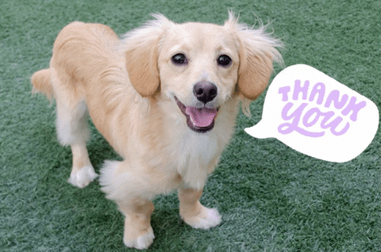
Thank YOu!

